Slide 1
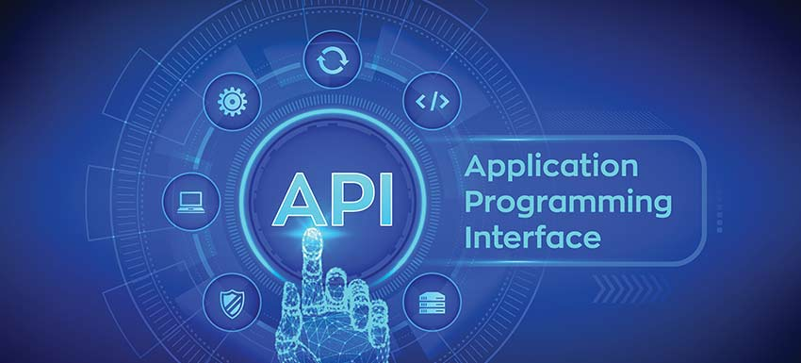

API Introduction
By Mithilesh Singh

Slide 2
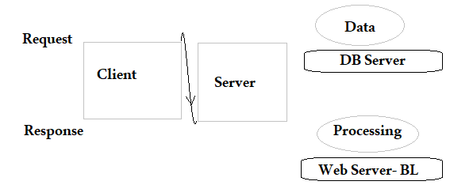
Client and server:
Client: A computer (hardware/software) that access the service made available by the Server.
Server: A server is a physical computer, dedicated to run the services to serve the needs of other computers.

Slide 3
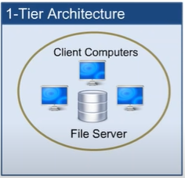
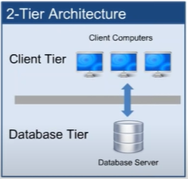
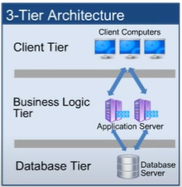
Client Server Architecture

Slide 4
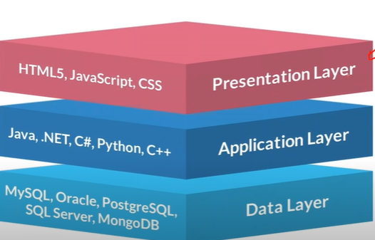
1. 1-Tier Architecture: Both Client and Server will be in the single machine. E.g. all the desktop application like notepad, excel etc. it is a presentational layer. 2. 2-Tier Architecture: Both Client and Server will be reside in different system. E.g. this is basically the client server application. User enter the details in the application which stores directly in the database. It contains presentational and Data layer 3. 3- Tier Architecture: There are three layer in this architecture, client, webserver and database server. First client send the request which goes to webserver where actual business logic is implemented, it process the request and send it to database server. It contains Presentational, Application and Data layer.

Slide 5
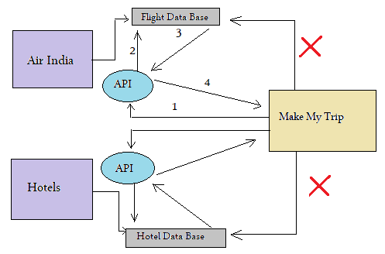
API: It stands for Application programming interface.
it enables communication and data exchange between two separate software system.
A software system implementing an API contains functions/sub-routines which can be executed by another software system.

Slide 6
API Testing:
1. API testing is entirely different from GUI Testing and mainly concentrated on the business logic layer of the software architecture. This testing won't concentrate on the look and feel of an application.
2. API Testing requires an application to interact with API. In order to test an API, you will need to
a. Use Testing tool to drive the API
b. Write your own code to test the API.

Slide 7
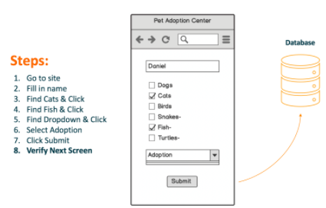
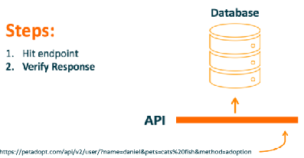
Example:
With API Testing, this entire testing scenario can, and should, be boiled down to one step:

Slide 8
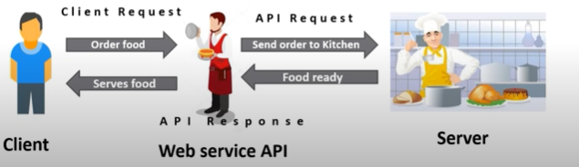
Web Services
Web service stands for service available on web
enables communication between application over the web
provides a standard protocol/format for communication

Slide 9
Componentes of Web Service
Components of webservice:
1. UDDI: universal Description, discovery and integration
it contains WSDL file/files
2. WSDL: web service description language, an xml based language
it contains API location along with input and response needed to test the API(xml format)
1. UDDI 2. WSDL

Slide 10
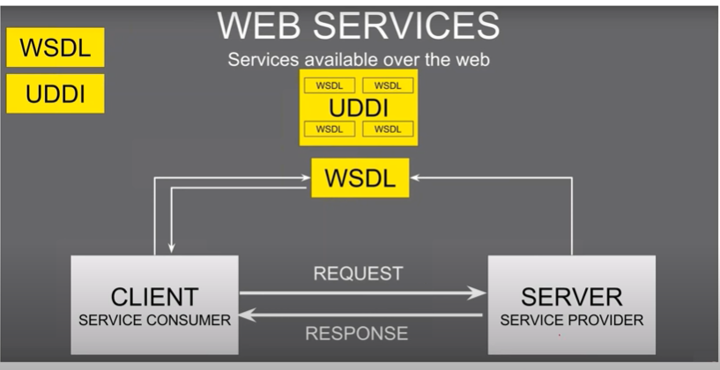

Slide 11
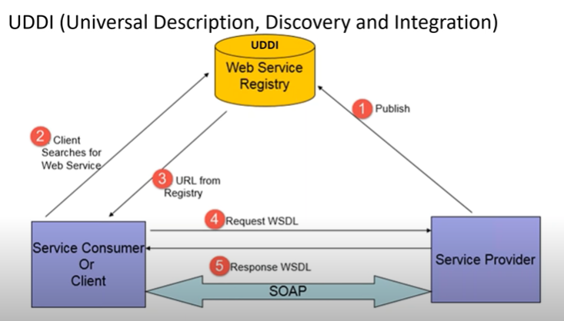
Work Flow Steps:

Slide 12
Steps: 1. Developer will create the API and keep all the information under wsdl. 2. Placed that wsdl under the UDDI 3. Testers will take the wsdl from the uddi 4. Get the information from wsdl like input, output and format 5. Send the request to the server based on those information 6. Get the response and compare it will the available output and then verify.

Slide 13
Types of Webservice
SOAP: It is a protocol which was designed before REST and came into the picture. The main idea behind designing SOAP was to
ensure that programs build on different platforms and programming languages could exchange data in an easy manner
Note: It only use Post method.
REST: This was designed Specially for working with components such as media components,
files, or even objects on a particular hardware device. Any web service
that is define on the principles of REST can be called a RESTful web service.
A RESTful service would use the normal HTTP verbs of Get, POST, PUT, DELETE for working with the required components.
There are mainly two types of web services
1. SOAP web service: Simple Object Access Protocol
2. RESTful web services. (Representational state transfer). Note: Soap uses WSDL

Slide 14
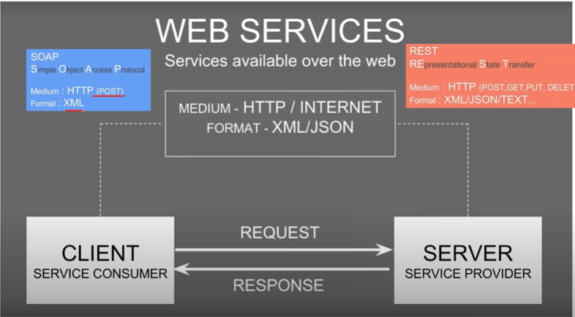

Slide 15
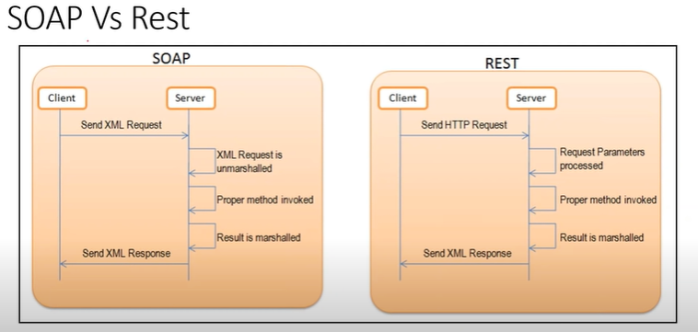

Slide 16
Difference between Http/https
HTTP: Hypertext Transfer protocol. At its most basic, it allows for the communication between different systems. it's most commonly used to
transfer data from a web server to a browser
in order to allow users to view we pages.
it's the protocol that used for basically all early websites
HTTPS: Hypertext Transfer protocol Secure. The problem with the regular HTTP is that the
information that flow server to browser is not encrypted which means
it can be easily stolen. HTTPS protocols remedy this by using an SSL(secure sockets layer) certificate, which helps create a secure encrypted
connection between the server and the browser.
1. http: Hypertext Transfer protocol. 2. https: Hypertext Transfer protocol Secure.

Slide 17
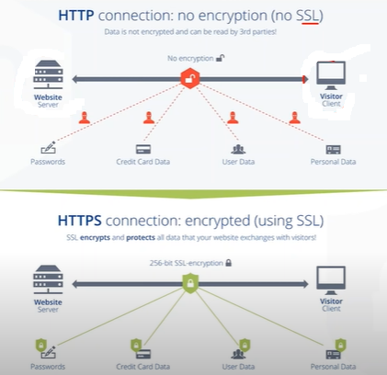

Slide 18
Challenges:
1. Initial setup of API Testing
2. Updating the schema of API Testing
3. Sequencing the API calls
4. Validating Parameters.

Slide 19
API Testing tools:
SoapUI
Postman
Katalon
Assertible
apigee
JMeter
REST-assured
Tricentis
Karate

Slide 20
Thank you

